Slide 1
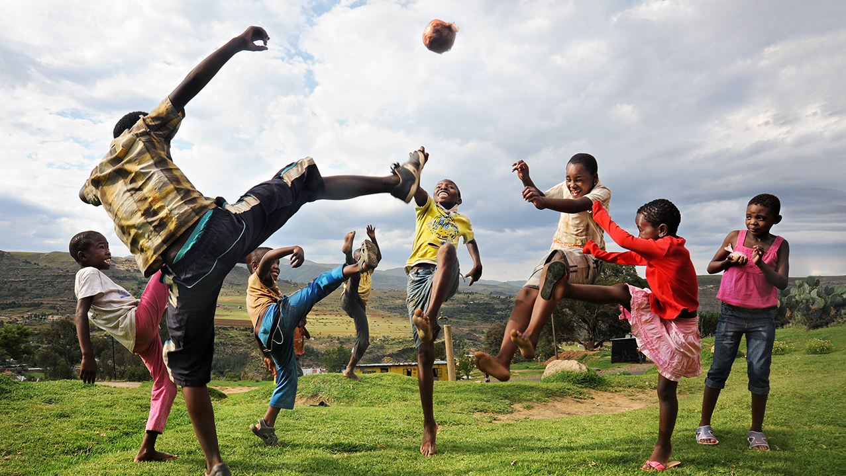
Can you imagine a world
without play?
1
Notes:
Can you imagine a world without play?
How would your life be different?
How would you feel?
Who would be affected?

Slide 2
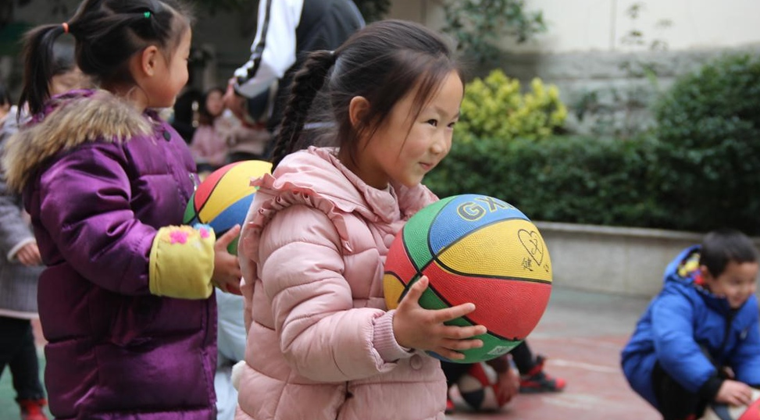
What is play?
Fun
Enjoyable
Active
Engaging
No restrictions
Meaningful
Voluntary
Notes:
What is play?
How would you describe play? What words would you use?
When you think of play, what activities are you doing?
How do you feel when you play?
What is your favourite kind of play?
Here are some examples of words that define ‘Play’
Fun?
Enjoyable?
Active?
Engaging?
Free of restrictions?
Voluntary?

Slide 3
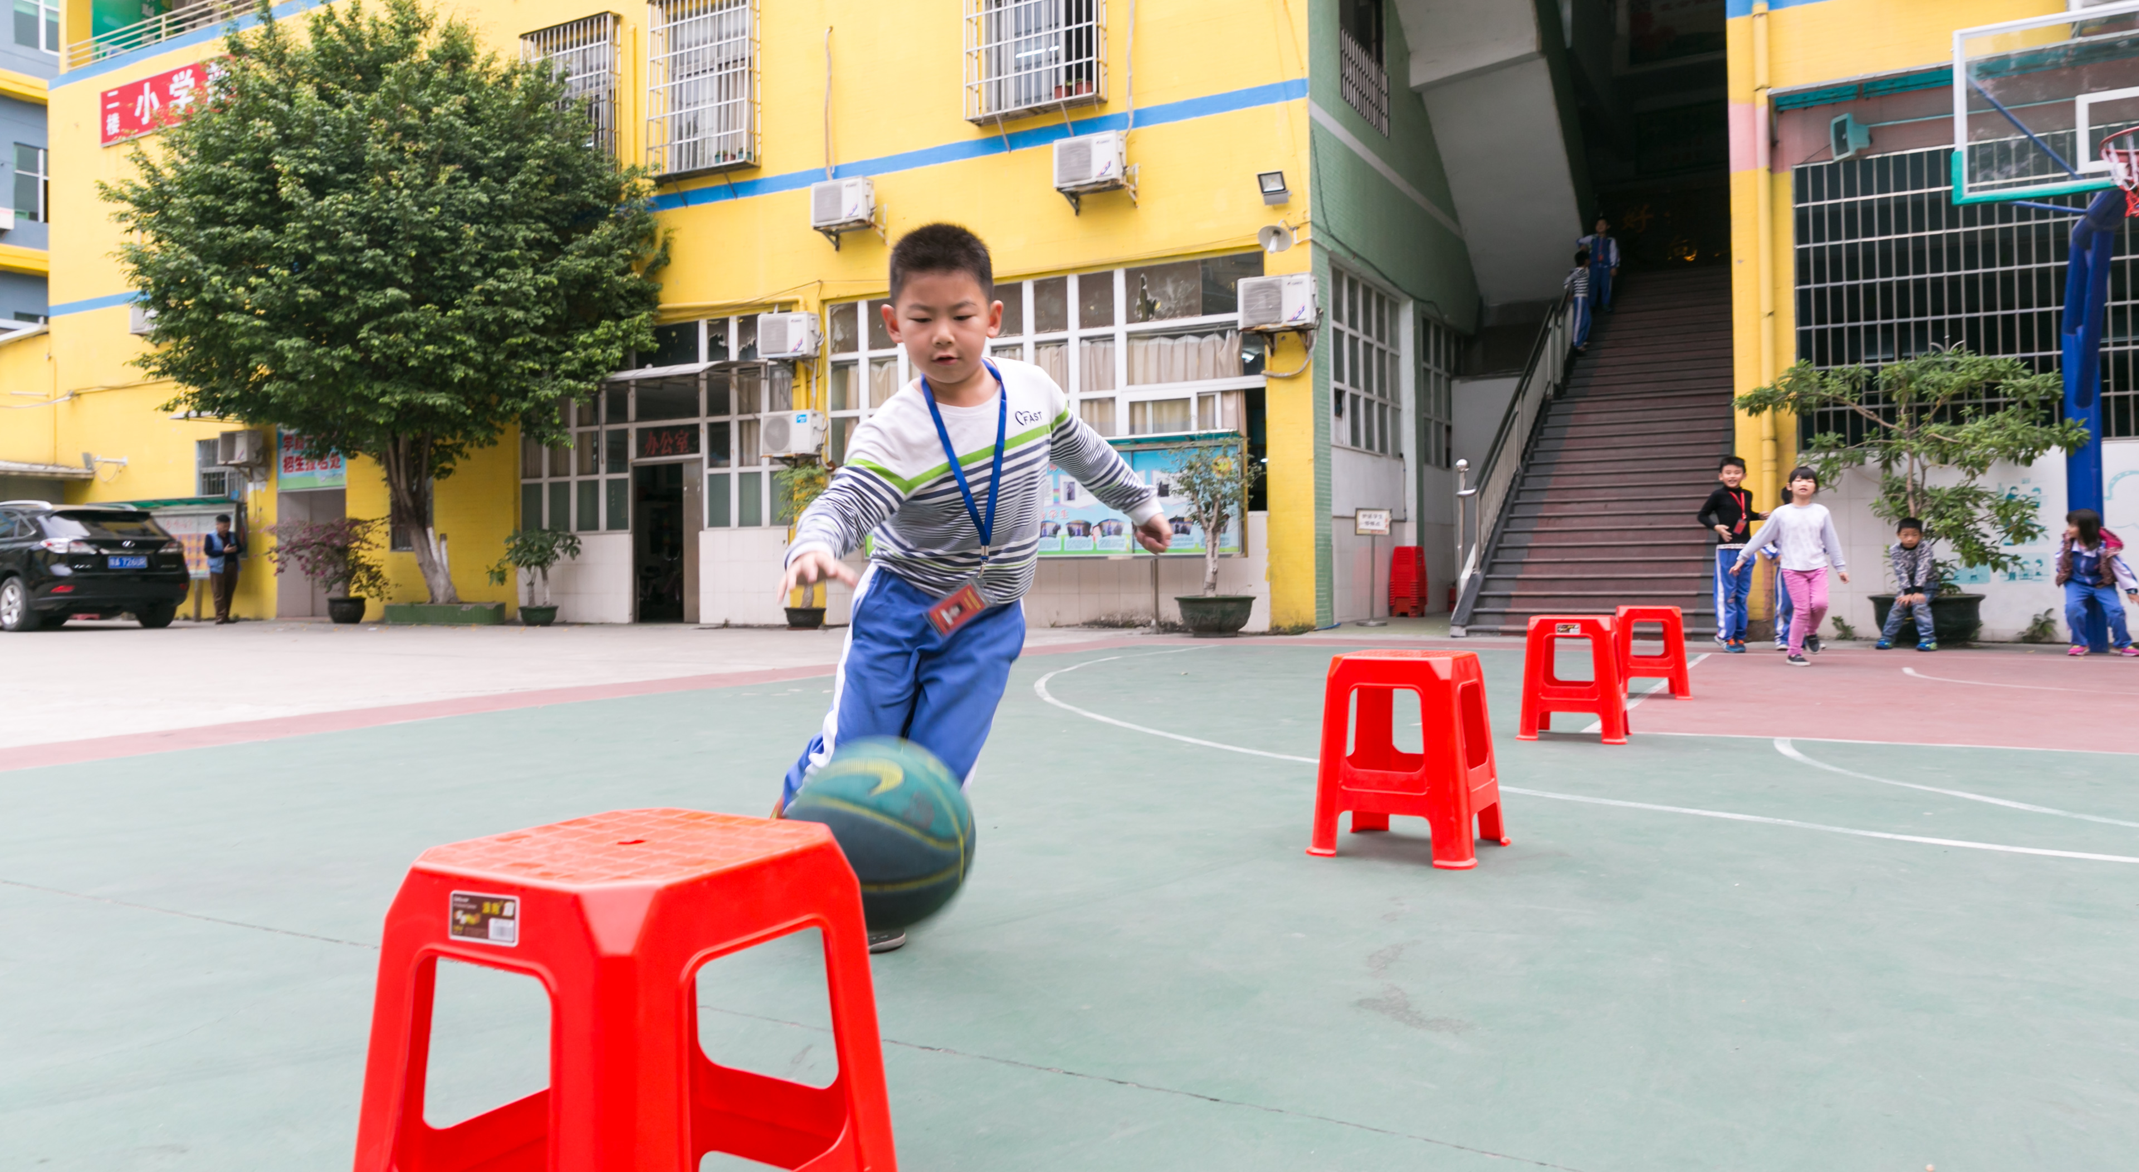
Is this play?
3
Notes:
Have a look at each of these 5 pictures and think about – Is this play?
Remember, play can come in many different shapes and sizes.
Which features of play do you see here?
Is it:
Fun?
Enjoyable?
Active?
Engaging?
Free of restrictions?
Voluntary?

Slide 4
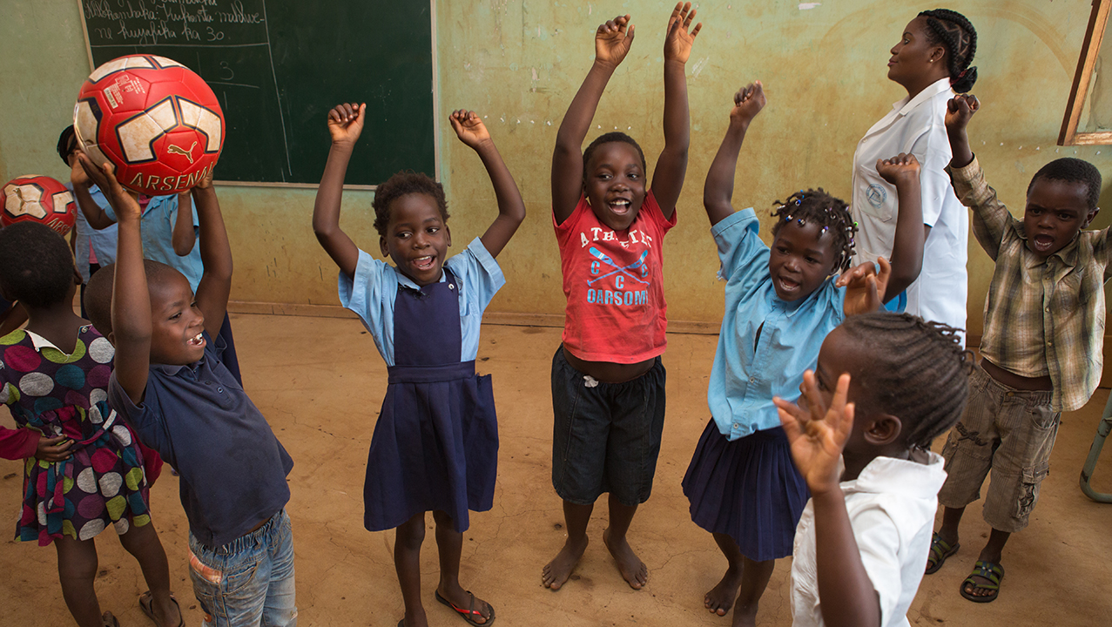
Is this play?
4
Notes:
Is this play?

Slide 5
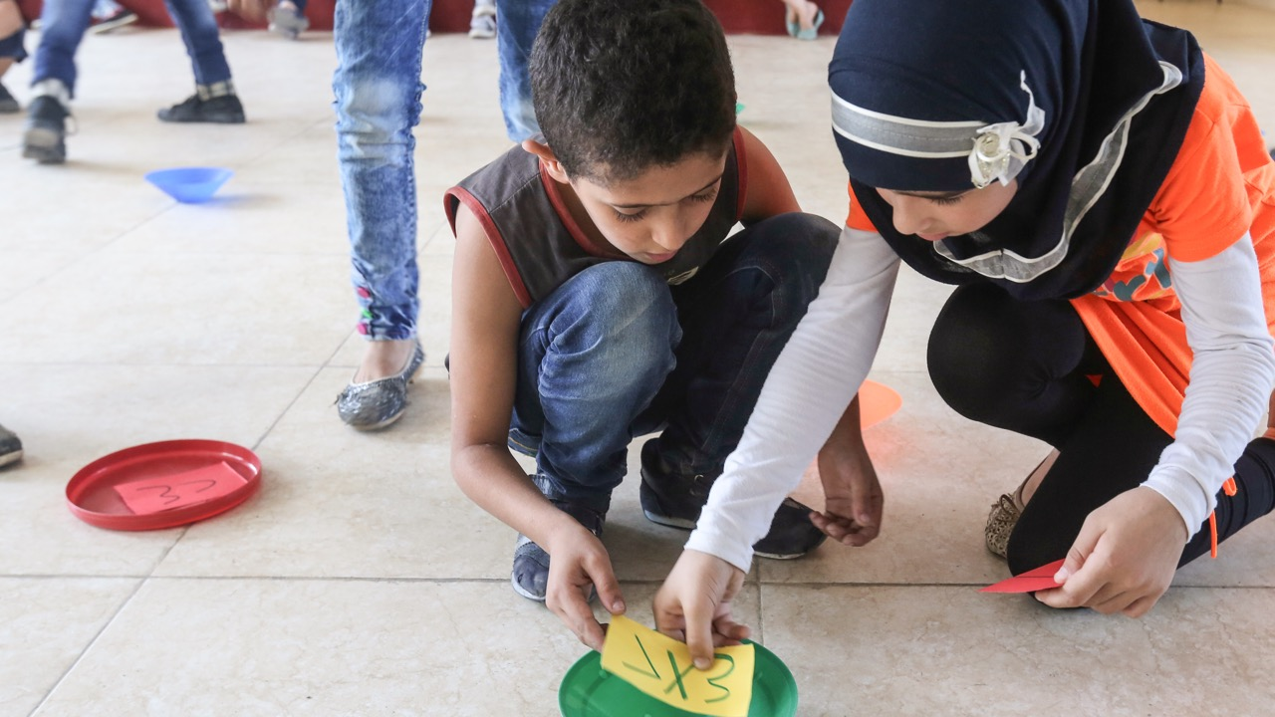
Is this play?
5
Notes:
Is this play?

Slide 6
Is this play?
6
Notes:
Is this play?

Slide 7
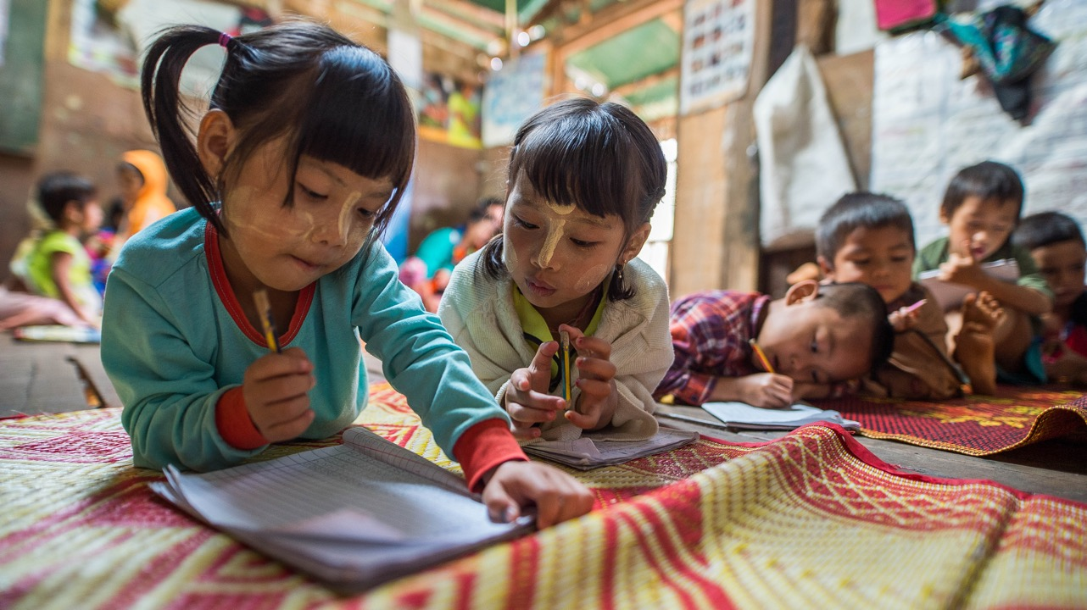
Can you learn through play?
Is this play?
7
Notes:
Is this play?
Can you learn through play / is it possible to learn things while you are playing?

Slide 8
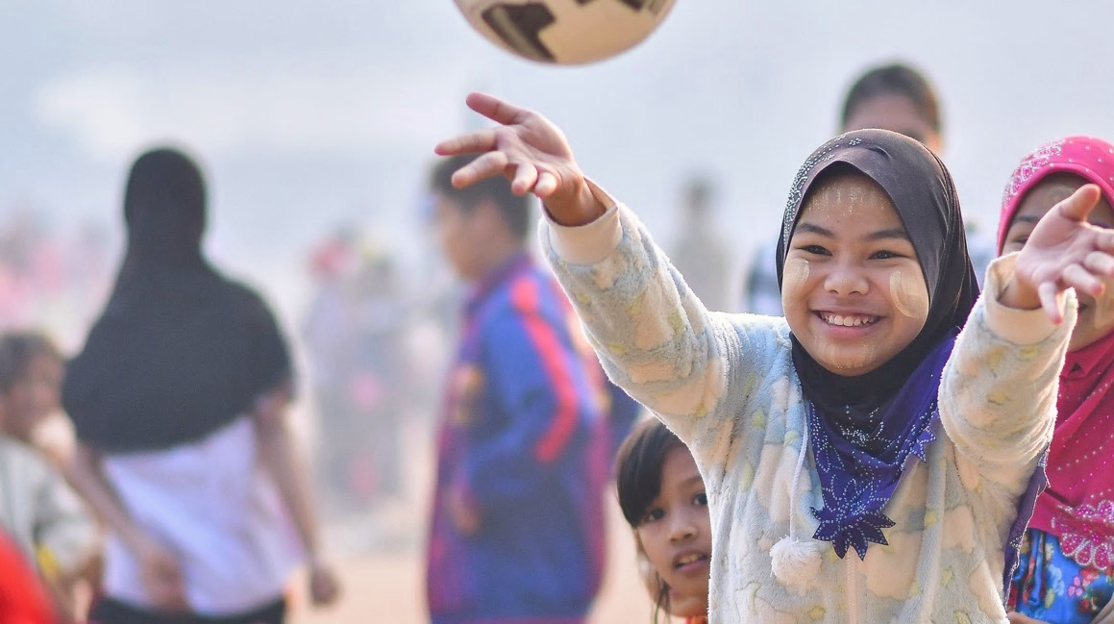
Why is play important?
1
Play is for everyone
2
Play gives us confidence
3
Play is brain-building
4
Play helps us develop
5
Play helps us learn
Notes:
Why is play so important?
Play is for everyone
Play gives us confidence
Play is brain-building
Play is at the heart of child development
Play is essential to learning
Additional notes:
Scientific evidence shows that play is essential to social, emotional, cognitive and physical development of children.
Play allows children to express themselves, use their imagination, be creative, grow confidence and learn about others in a comfortable and positive environment
The UN recognizes play as the right of every child. Play is not a luxury; it is a tool for education and health. It can bring entire communities together and inspire every individual.
Play helps teach important life lessons and develop skills like cooperation, leadership and teamwork. For example, a game of football can teach children about tolerance, resilience and how to support others.

Slide 9
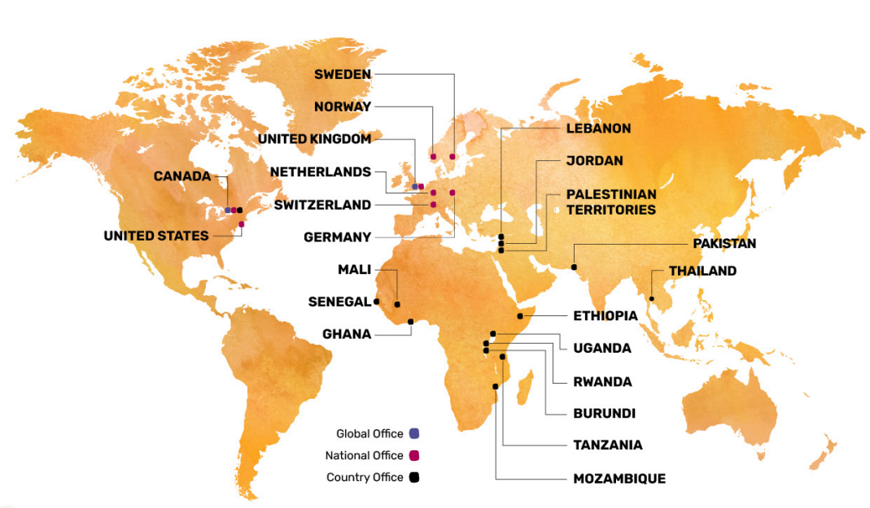
Right To Play helps children around the world
9
Notes:
Right To Play work in 15 countries and use the power of play to do 4 main things:
Help children learn and access education
Teach communities about health and well-being
Protect children and help them avoid danger and violence
Promote gender equality, give girls a voice and provide them with safe spaces to learn and play

Slide 10
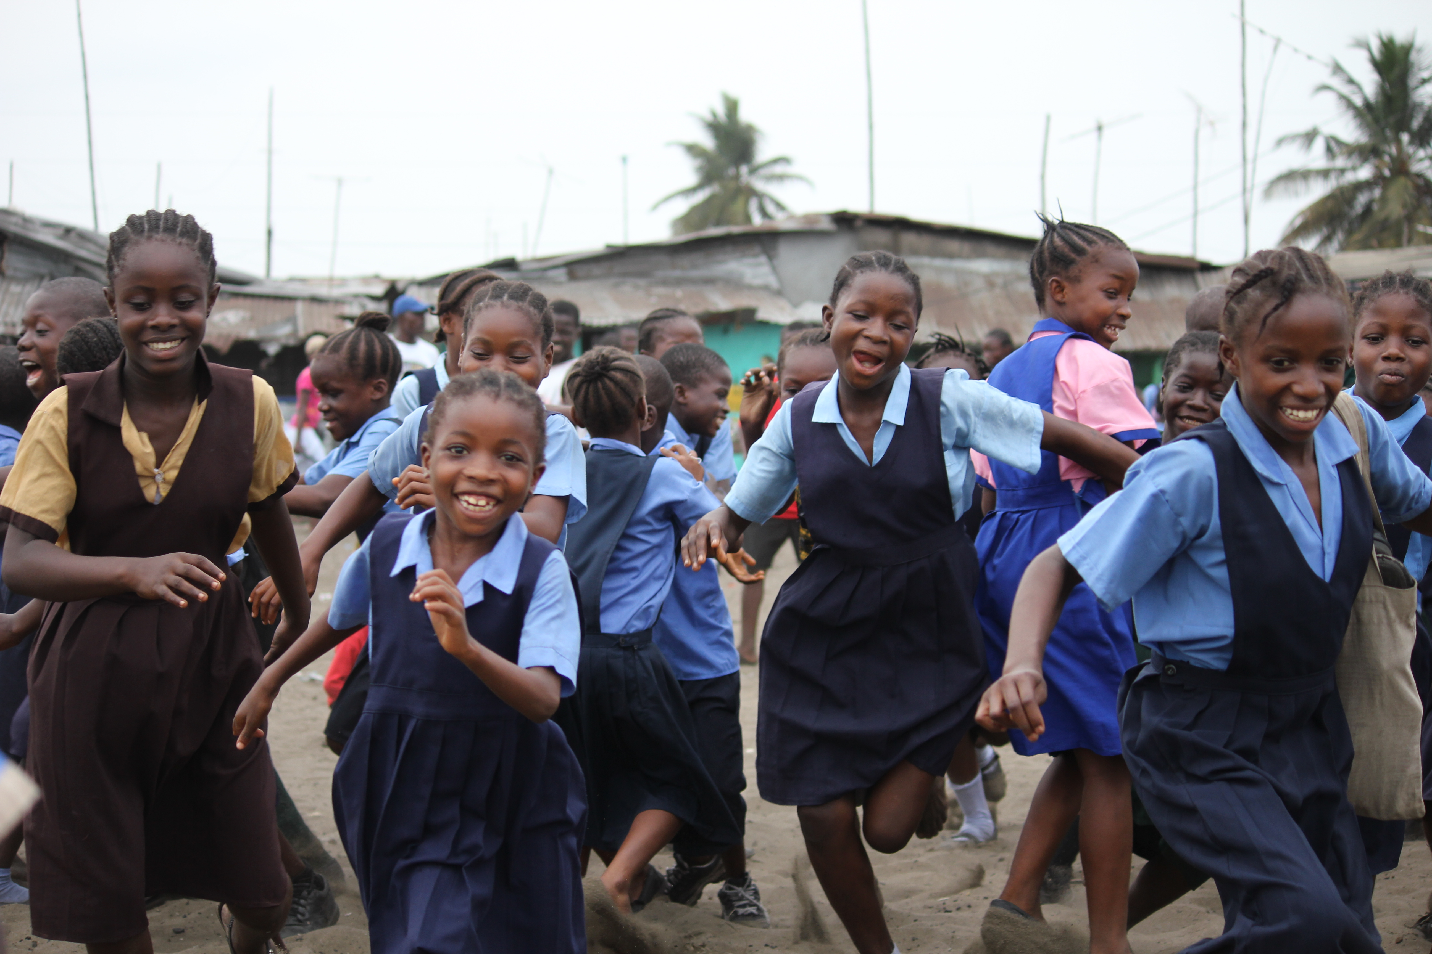
Every child has the right to play and learn.
Notes:
Which children have the right to play and learn?
Do boys and girls have the same right to play and learn?
Do children in other countries have the same right to play and learn?
Is there anyone who shouldn’t have the right to play?
Every child has the right to play and learn.
Play is a human right (defined in Article 31 of the Convention on the Rights of the Child)
Education is a human right (defined in Article 28 of the Convention on the Rights of the Child)
Some children around the world do not have the opportunity to learn and play.

Slide 11
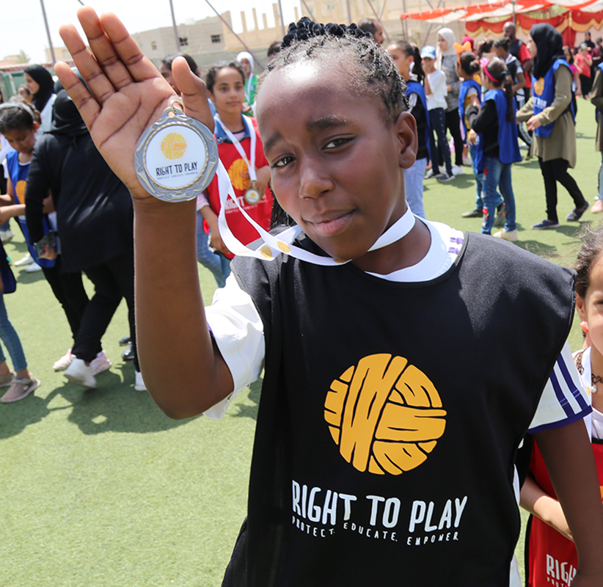
Hi! My name is Tala.
I live in the
Al Khalidiyah
in Jordan.
11
Notes:
This is Tala.
She is 13-years-old and lives in the Al Khalidiyah, Jordan.
Has anyone heard of Jordan / Where in the world would you find Jordan?
Stand up / put your hand on your head if you think Tala has the same rights as you.
Even though some places are very far away from us, all children in the world have the same rights, including the right to play and learn.
Right To Play helps make sure children like Tala have access to their rights.

Slide 12
Do girls and boys have the same rights?
12
Notes:
Watch this video about Tala:
https://www.youtube.com/watch?v=eJpOnx3rpl8
What challenges does Tala face in her life?
In Tala’s community, do boys and girls have the same rights?
How does Tala feel when she is able to play?
How does Right To Play help Tala and girls in her community?

Slide 13
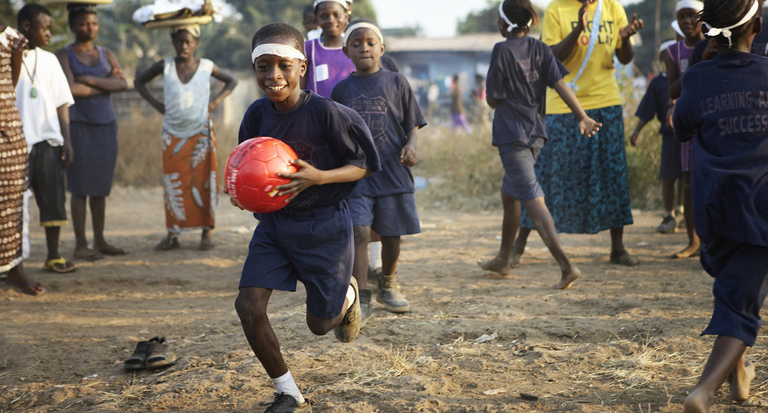
How can we help?
Notes:
We are going to be supporting Right To Play to raise money for children around the world!

Slide 14
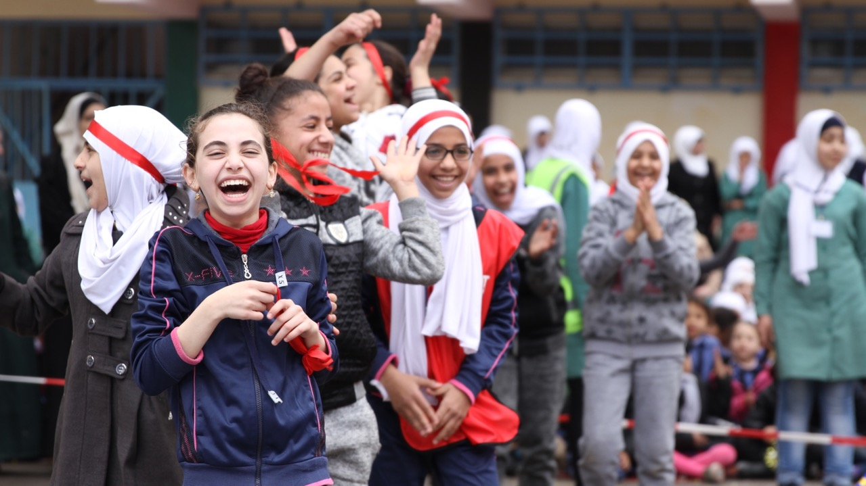
We're holding a Play Day!
[Date]
[Fundraising goal]
[Activity details]
14
Notes:
Add details of your Play Day:
Date
Fundraising goal
Activities / discuss ideas
Who to contact
Next steps?

Slide 15
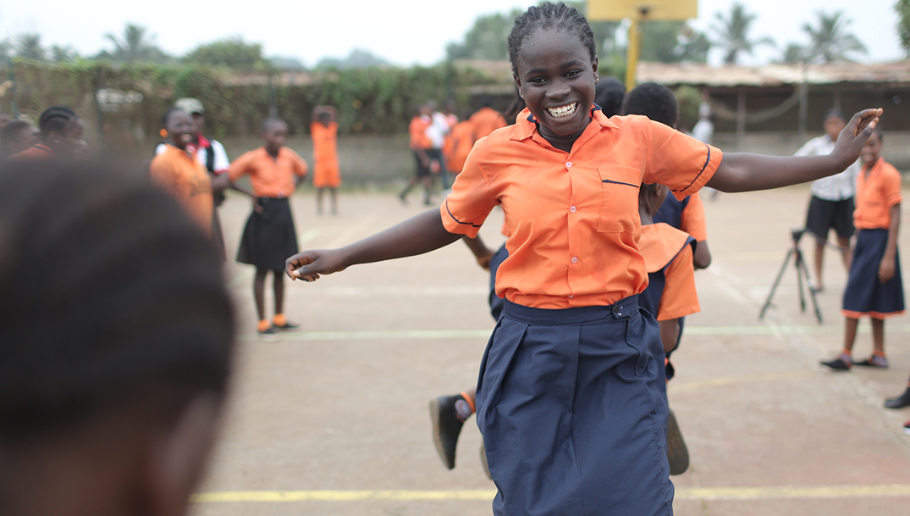
What could our fundraising buy?
£3,000 could help create a safe space for children to learn and play
£1,500 could help keep 50 children in school for a year
£500 could provide 10 children with mental and emotional support
£150 could help give a child with a disability the resources to fully participate in school
£50 could help provide hygiene kits for 4 children and their families to stay protected from diseases like COVID-19 and Malaria
Notes:
The money we raise from our Play Day will help make sure more children and girls around the world are able to play, learn and achieve their dreams.
£3,000 could help to create a safe space for children to learn and play
£1,500 could help keep 50 children in school for a year – a whole class in a Right To Play programme!
£500 could help provide 10 children who've survived disaster with mental and emotional support
£150 could help give a child with a disability the resources to fully participate in school
£50 could help provide hygiene kits for 4 children and their families to stay protected from diseases like COVID-19 and Malaria

Slide 16
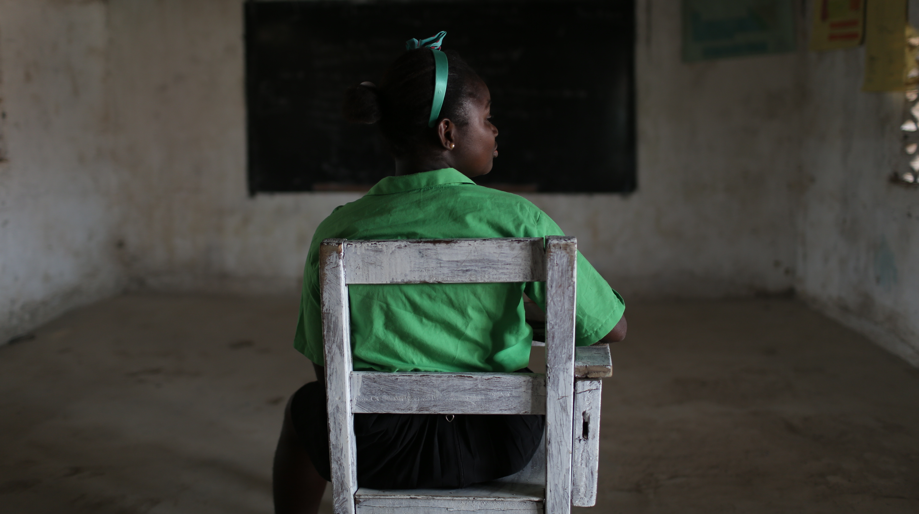
The power of play.
Notes:
Watch this video:
https://www.youtube.com/watch?v=xxWsAilOVg0

Slide 17
Let’s play!
www.righttoplay.org.uk

